Slide 1
ARTEMIS
GET UNBORED
Ahmet Sen, Doug Achkar, Alexander Umale

Slide 2
There are many activities out there
Finding an interesting one and getting started can be tough...

Slide 3
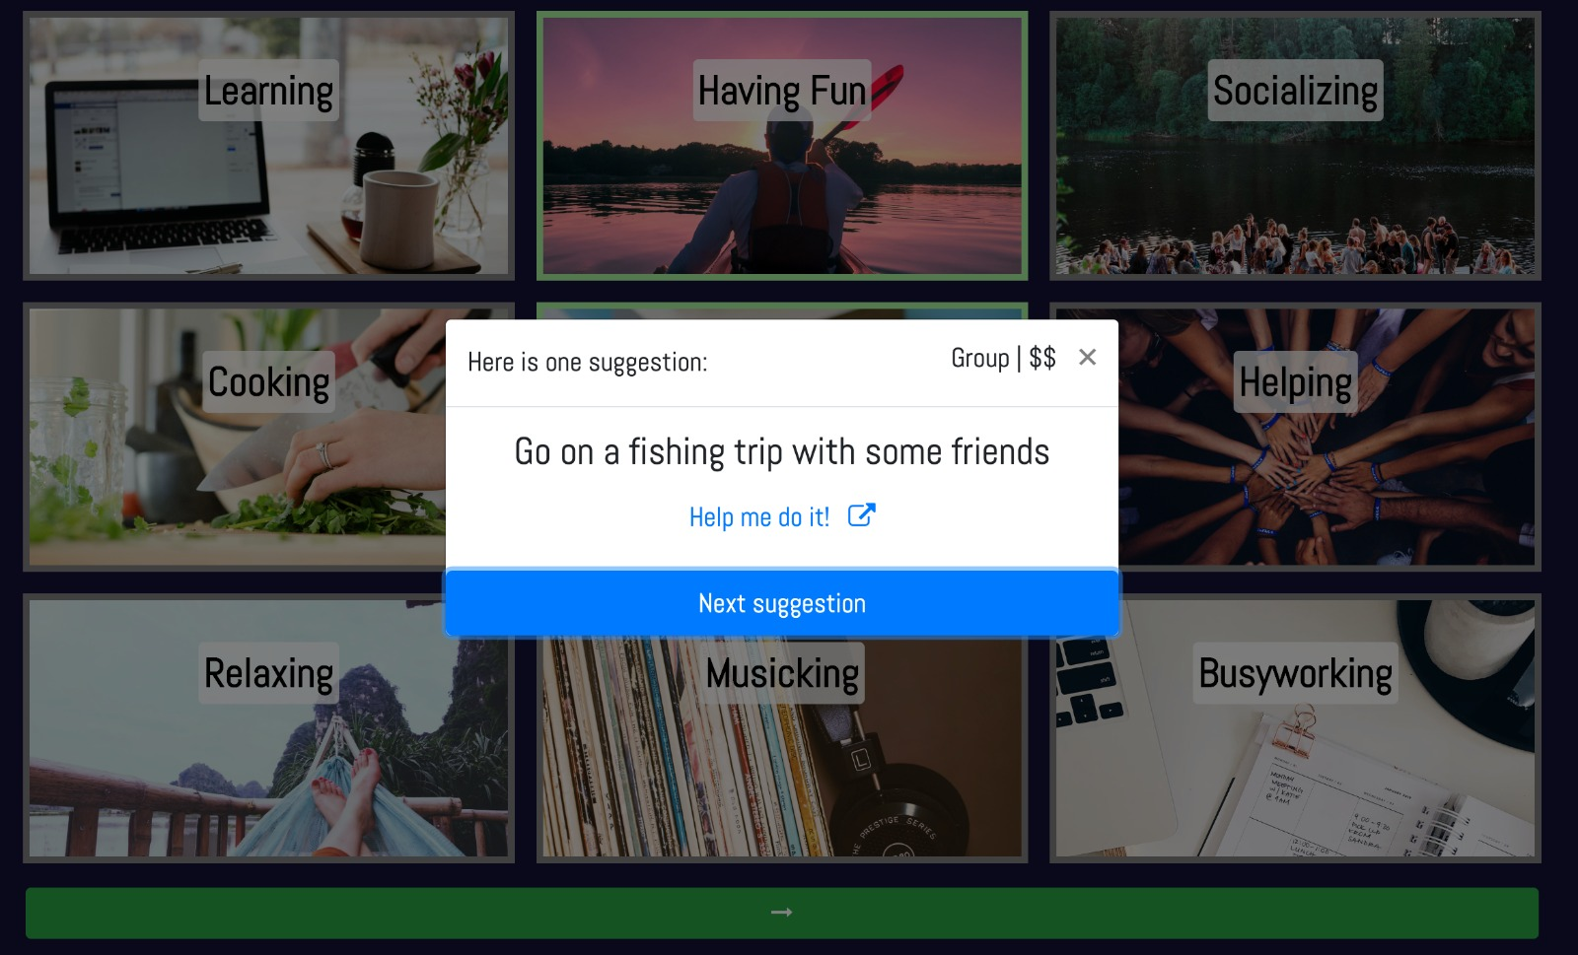

Slide 4
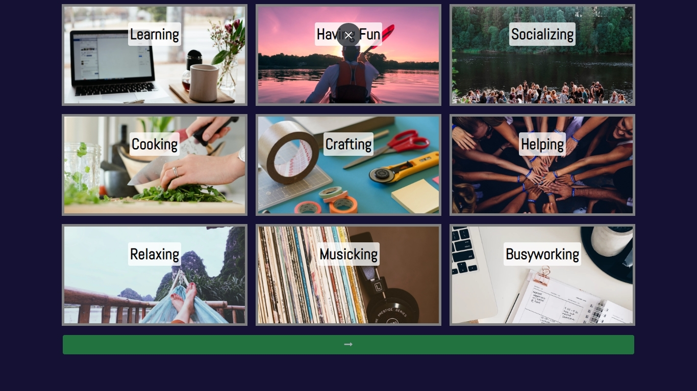
WORKS FOR DESKTOP
Place your screenshot here

Slide 5

AND ALSO MOBILE
Place your screenshot here

